Slide 1
Fuzzy logic
Session 16
Henry Lucky, S.Kom., M.Kom.

Slide 2
Learning Outcomes
Session 16
At the end of this session, students will be able to:
LO 4: Apply various techniques to an agent when acting under certainty

Slide 3
outline
Session 16
Fuzzy Expert System
Fuzzy Inference System

Slide 4
Fuzzy expert system
definition
There are four basic operations
  Fuzzification : Membership function assignment
  Inference : Fuzzy rule definition
  Composition : Combination of the rule outputs
  Defuzzification : Crisp output calculation

Slide 5
Fuzzy inference system
definition
There are three popular fuzzy inference system
  Mamdani (Mamdani and Assilian produced the first fuzzy controller)
  Takagi-Sugeno
  Tsukamoto

Slide 6
Fuzzy inference system
mamdani
Let’s say we have a simple following case with two inputs, one output, and three rules (with its simplified translation)
  Rules:
    If fund is adequate OR n_staff is small, then risk is low
    If x is A3 OR y is B1, then z is C1
    If fund is marginal AND n_staff is large, then risk is normal
    If x is A2 AND y is B2, then z is C2
    If fund is inadequate, then risk is high
    If x is A1, then z is C3

Slide 7
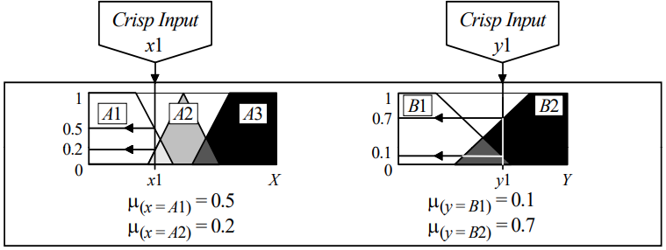

Fuzzy inference system
mamdani
To make it simple, let’s assume that we already know the membership function, we want to check a custom input (x1 and y1) membership degree
  $μ_{(x=A1)}=0.5$
  $μ_{(x=A2)}=0.2$
  $μ_{(y=B1)}=0.1$
  $μ_{(y=B2)}=0.7$

Slide 8
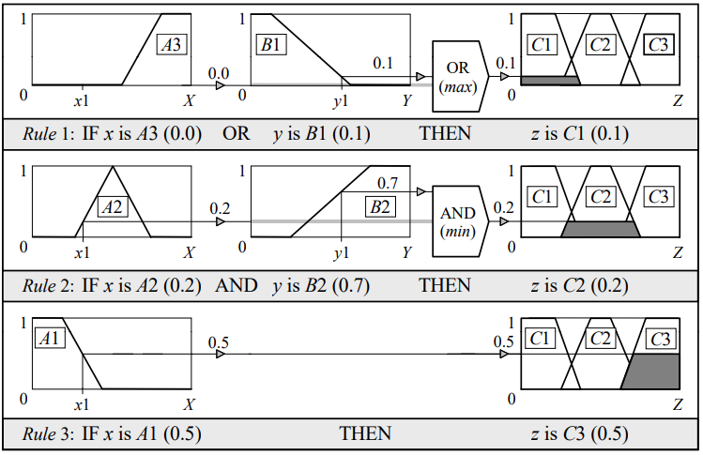
Fuzzy inference system
mamdani
Now, we want match the (assumed) information with the rules

Slide 9
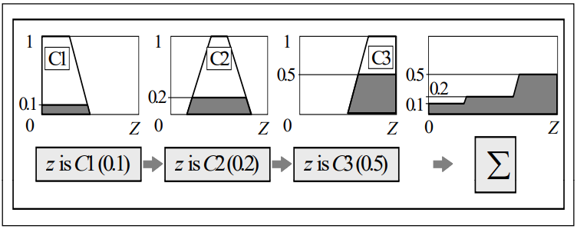
Fuzzy inference system
mamdani
Now, we can aggregate the obtained rule outputs into a single fuzzy set

Slide 10
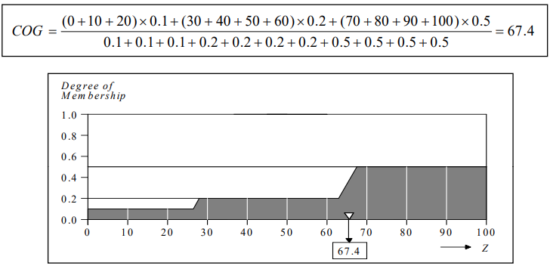
Fuzzy inference system
mamdani
Lastly, to determine the value of z we can use center of gravity method (among many others ofc)

Slide 11
Fuzzy inference system
Mamdani discussion
For Mamdani controllers, the output sets are singletons (i.e. a single set), or combinations of singletons where the combinations are achieved through application of the fuzzy set operators.
Output sets can, however, also be linear combinations of the inputs.
Takagi and Sugeno suggested an approach to allow for such complex output sets, referred to as Takagi-Sugeno fuzzy controllers

Slide 12
Fuzzy inference system
Takagi-sugeno
Let’s say we want to determine the health of a person based on the height and the weight
Input: Height and Weight
Output : Health level (and its degree)
  Very healthy (0.8)
  Healthy (0.6)
  Somewhat healthy (0.4)
  Not healthy (0.2)

Slide 13
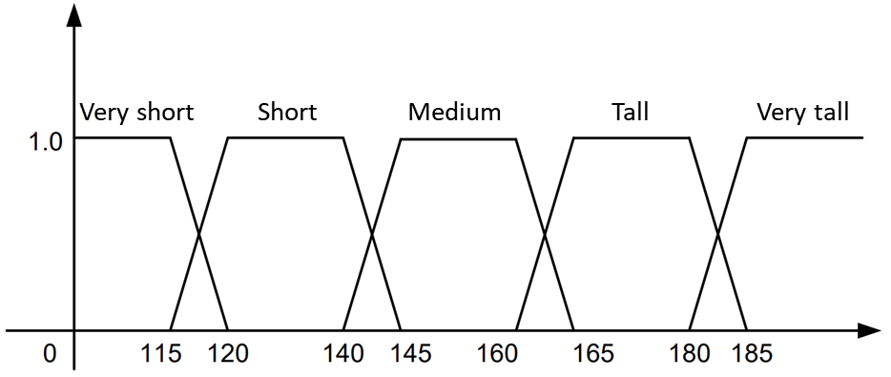
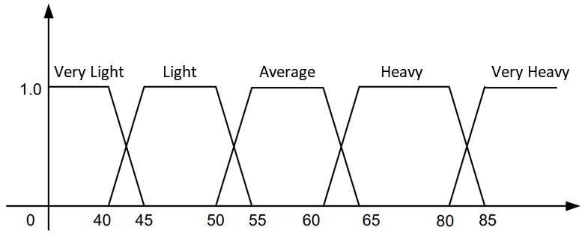
Fuzzy inference system
Takagi-sugeno
Let us determine the membership function for height and weight

Slide 14
Fuzzy inference system
Takagi-sugeno
Then we would set the rules
 | Weight
Height |  | V. Light | Light | Average | Heavy | V. Heavy
 | V. Short | VH | H | SH | NH | NH
 | Short | H | VH | H | SH | NH
 | Medium | SH | VH | VH | SH | NH
 | Tall | NH | H | VH | H | NH
 | V. Tall | NH | SH | VH | H | SH

Slide 15
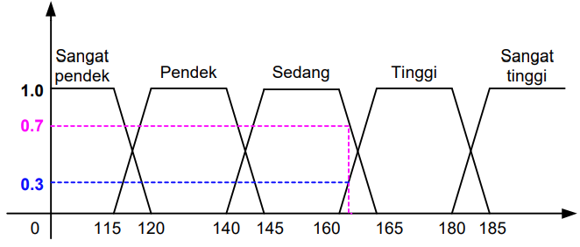
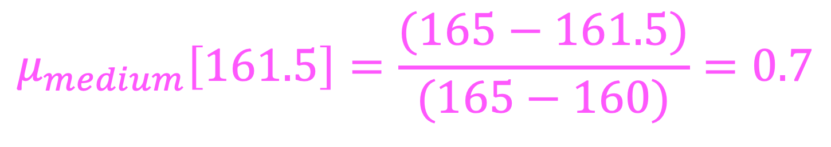
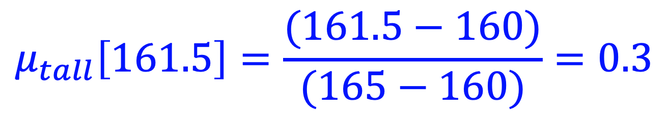
Fuzzy inference system
Takagi-sugeno
Determine the membership value
$$μ_{medium}\left[161.5\right]=\frac{(165−161.5)}{(165−160)}=0.7$$
$$μ_{tall}\left[161.5\right]=\frac{(161.5−160)}{(165−160)}=0.3$$

Slide 16
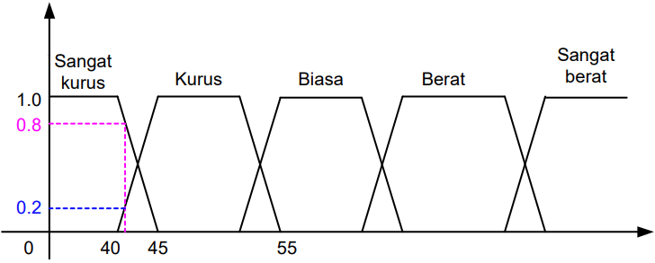
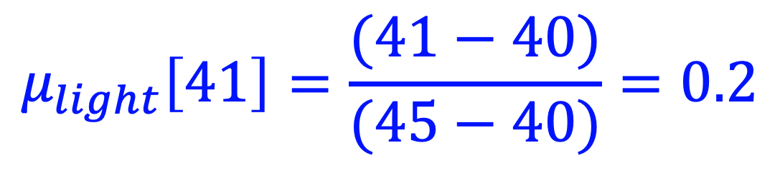
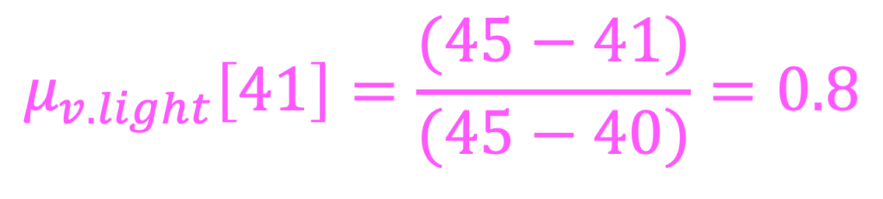
Fuzzy inference system
Takagi-sugeno
Determine the membership value
$$μ_{v. light}\left[41\right]=\frac{(45−41)}{(45−40)}=0.8$$
$$μ_{light}\left[41\right]=\frac{(41−40)}{(45−40)}=0.2$$

Slide 17
Fuzzy inference system
Takagi-sugeno
Refer to the rules first. Pick the lowest score (because the relation is AND)

Slide 18
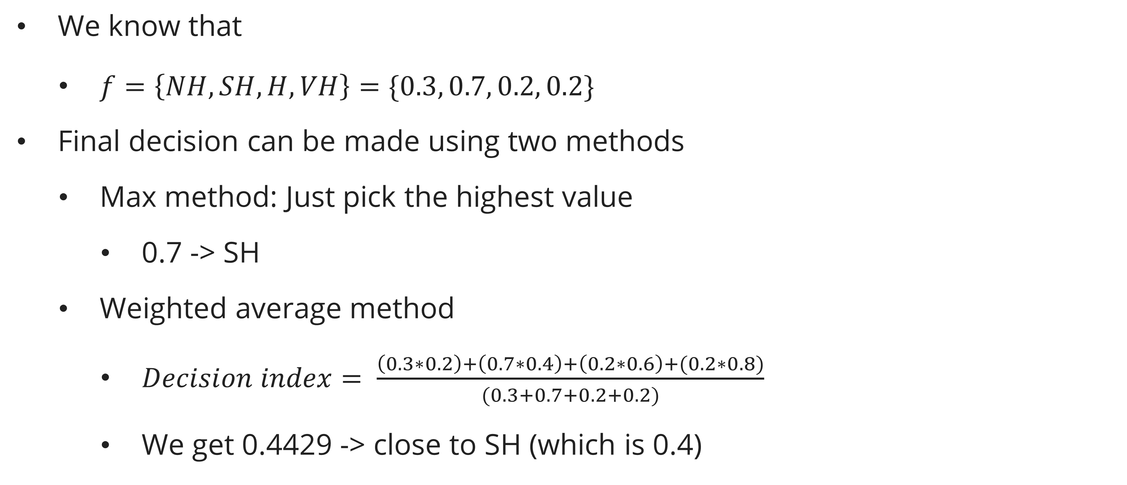
Fuzzy inference system
Takagi-sugeno
We know that
  $f=\left\{NH, SH, H, VH\right\}=\{0.3, 0.7, 0.2, 0.2\}$
Final decision can be made using two methods
  Max method: Just pick the highest value
    0.7 -> SH
  Weighted average method
    $Decision index= \frac{\left(0.3∗0.2\right)+\left(0.7∗0.4\right)+\left(0.2∗0.6\right)+(0.2∗0.8)}{(0.3+0.7+0.2+0.2)}$
    We get 0.4429 -> close to SH (which is 0.4)

Slide 19
Fuzzy inference system
Tsukamoto
Case:
  A factory has the following records:
    Max recorded demand 5k items a day and min 1k items a day
    Stock items has a record max of 600 items and min 100 items
    Max producing capability is 7k items a day and min 2k items a day
  Fuzzy rule:
    If demand is high and stock is high, then increase production
    If demand is low and stock is low, then decrease production
    If demand is low and stock is high, then decrease production
    If demand is high and stock is low, then increase production
  Question:
    How many items should be produced given the demand is 4k and there are 300 items in stock?

Slide 20
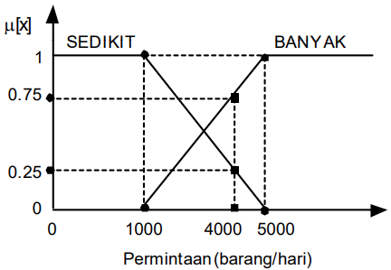
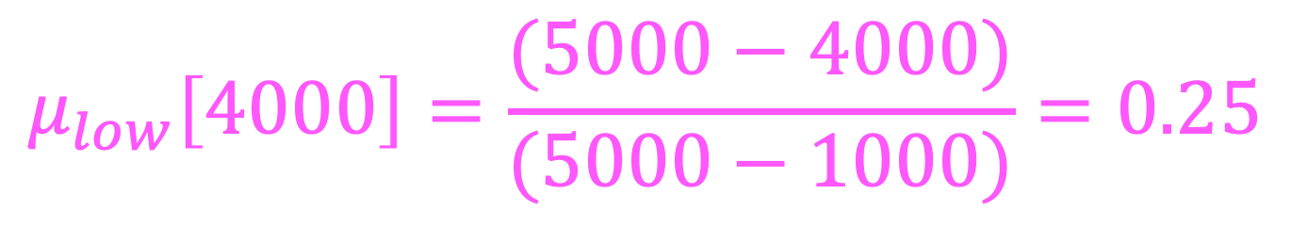
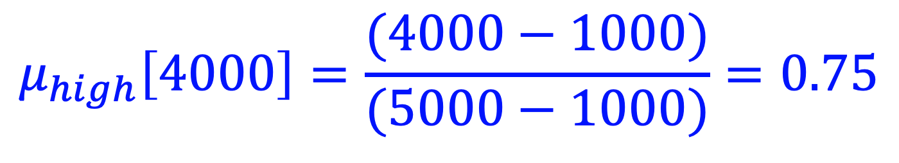
Fuzzy inference system
Tsukamoto
Make the membership function for both demand and stock
$$μ_{low}\left[4000\right]=\frac{(5000−4000)}{(5000−1000)}=0.25$$
$$μ_{high}\left[4000\right]=\frac{(4000−1000)}{(5000−1000)}=0.75$$

Slide 21
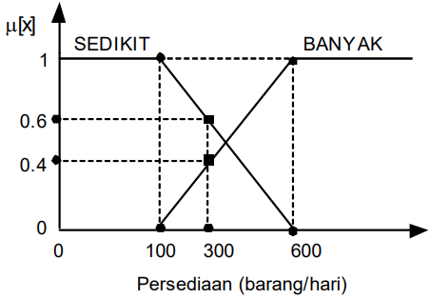
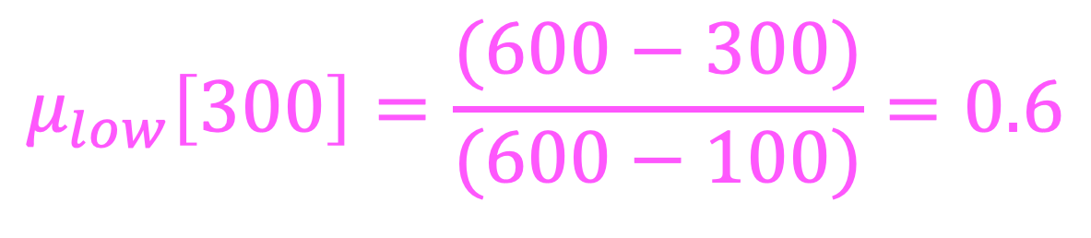
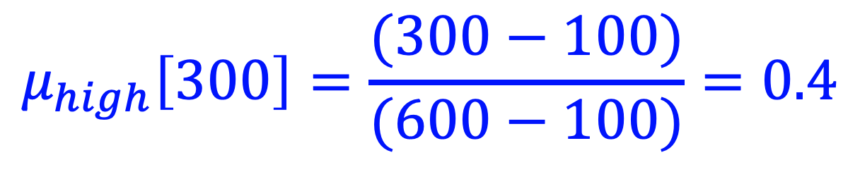
Fuzzy inference system
Tsukamoto
Make the membership function for both demand and stock
$$μ_{low}\left[300\right]=\frac{(600−300)}{(600−100)}=0.6$$
$$μ_{high}\left[300\right]=\frac{(300−100)}{(600−100)}=0.4$$

Slide 22
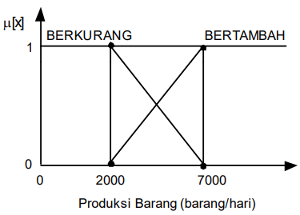
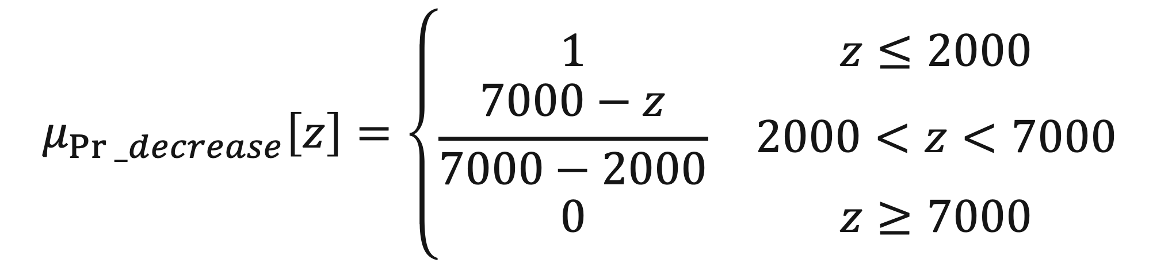
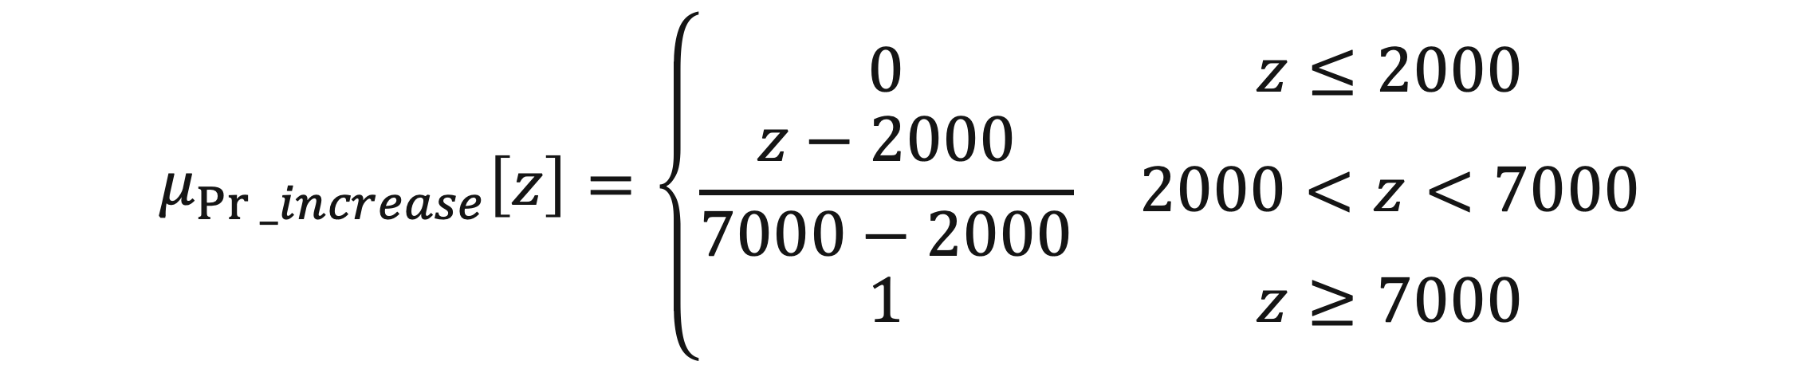
Fuzzy inference system
Tsukamoto
Make the membership function for production
$$μ_{Pr⁡_decrease}\left[z\right]=\left\{\begin{matrix}1 & z≤2000 \\ \frac{7000−z}{7000−2000} & 2000<z<7000 \\ 0 & z≥7000\end{matrix}\right.$$
$$μ_{Pr⁡_increase}\left[z\right]=\left\{\begin{matrix}0 & z≤2000 \\ \frac{z−2000}{7000−2000} & 2000<z<7000 \\ 1 & z≥7000\end{matrix}\right.$$

Slide 23
Fuzzy inference system
Tsukamoto
Now let’s make the truth table that show the relation between stock, demand, and production
Then we can set the membership degree values
Since the logic is set to “IF x AND y THEN z”, pick the minimum

Slide 24

Fuzzy inference system
Tsukamoto
We know that:
Now we want to find the $z$ that fulfills the $μ$ in the production

Slide 25

Fuzzy inference system
Tsukamoto
Finally, we can find the final number of the items that should be produced by:
$$Z=\frac{.4∗4000 + .6∗5000 + .25∗5750 + .25∗5750}{.4+.25+.25+.6}≈4983$$

Slide 26
Exercise
Assume you will develop a fuzzy system on a coffee maker. Where the input will consist of the amount of water and the amount of coffee used, while the output is the level of coffee consistency. If known:
  The amount of water is divided into 3 classes namely:
    Little, with alpha_min = 10ml, beta = 50ml and alpha_max = 150ml
    Medium, with alpha_min=100ml, beta=275ml and alpha_max= 350ml
    Many, with alpha_min=300ml, beta=400ml and alpha_max=500ml
  The amount of coffee is divided into classes:-
    Little, with alpha_min=10gr, beta=25gr and alpha_max=35gr
    Medium, with alpha_min=30gr, beta=45gr and alpha_max=55gr
    Large, with alpha_min=50gr, beta=65gr and alpha_max=75gr

Slide 27
Exercise
  Coffee viscosity levels are divided into 2 classes:
    thin, with alpha_min=0, beta=3 and alpha_max=5
    thick, with alpha_min=4, beta=7 and alpha_max=101.
  Draw the membership function of each variable on input and output.
  Given the following rule:
    R1: If the amount of water is small and the coffee is medium then the coffee is thick.
    R2: If the amount of water is small and coffee is large then the coffee is thick.
    R3: If the amount of water is medium and the coffee is little then the coffee is thin
    R4: If the amount of water is medium and the coffee is medium then the coffee is thin
If given the amount of water = 115ml and the amount of coffee = 32 gr, then determine the output of coffee viscosity using Tsukamoto Method!

Slide 28
Exercise
What are the other information needed to add to the problem if we want to use Mamdani and Takagi-Sugeno methods? Explain!

Slide 29
References
Session 16
Engelbrecht, A. P. (2023). Computational intelligence: an introduction 3rd edition. Wiley
Lee, K. H. (2004). First course on Fuzzy Theory and Applications. Springer Science & Business Media.

